Slide 1
Hospital

Slide 2
We created this project about the hospital. In this project, we created a database that includes all things. As we know, the hospital contains employees, doctors, nurses, patients and rooms. We made their tables and added the necessary information for each of them

Slide 3
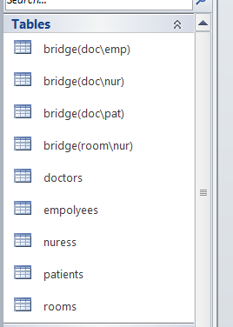

Slide 4
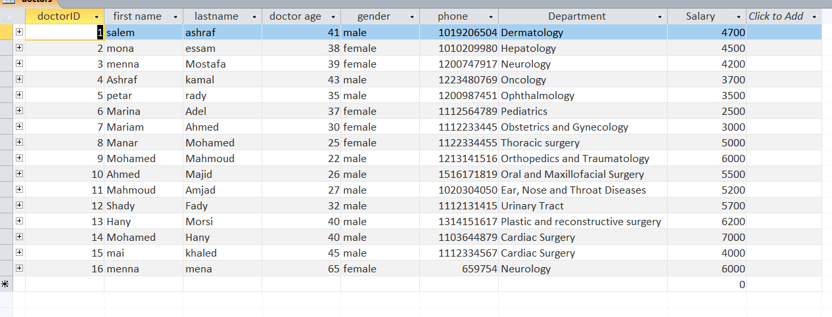
We have added the necessary data for employees, doctors, nurses, patients and room data as follows

Slide 5


Slide 6



Slide 7
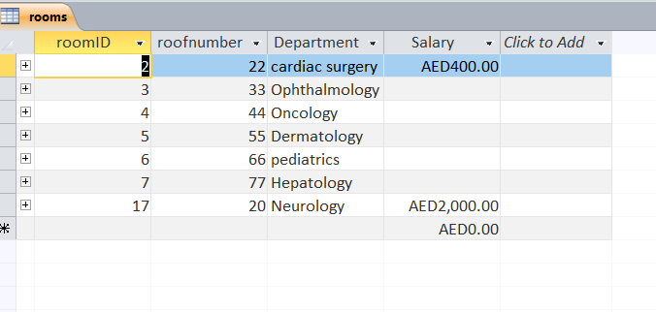

Slide 8
Relations
Then we defined the primary key for the tables and linked the tables together with relationships such as One to Many One to one ,many to many

Slide 9
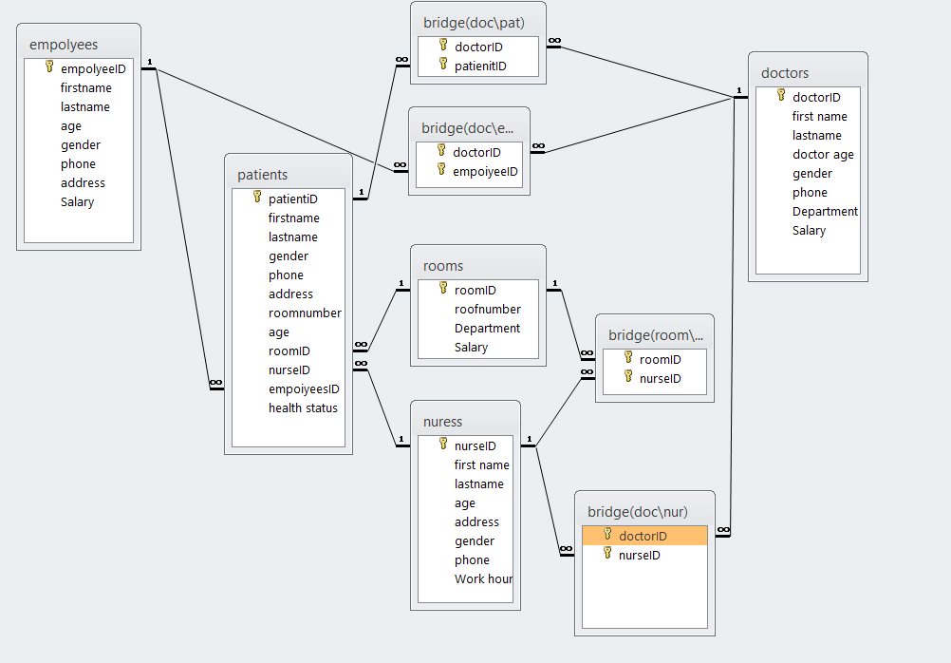

Slide 10
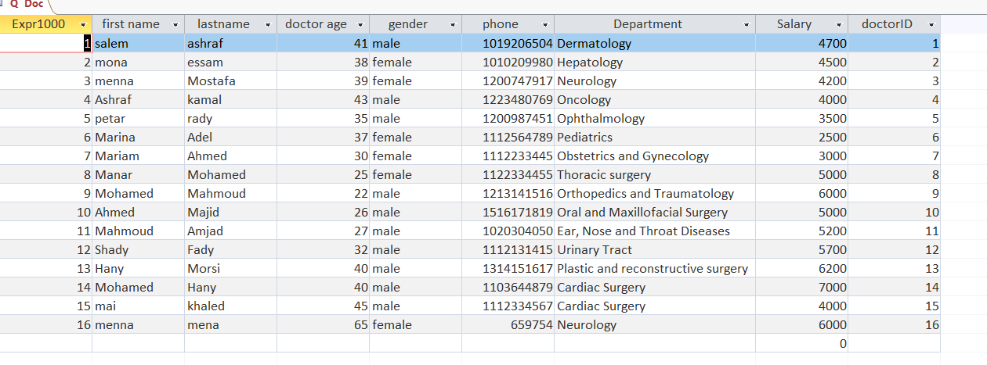
Query SEL

Slide 11
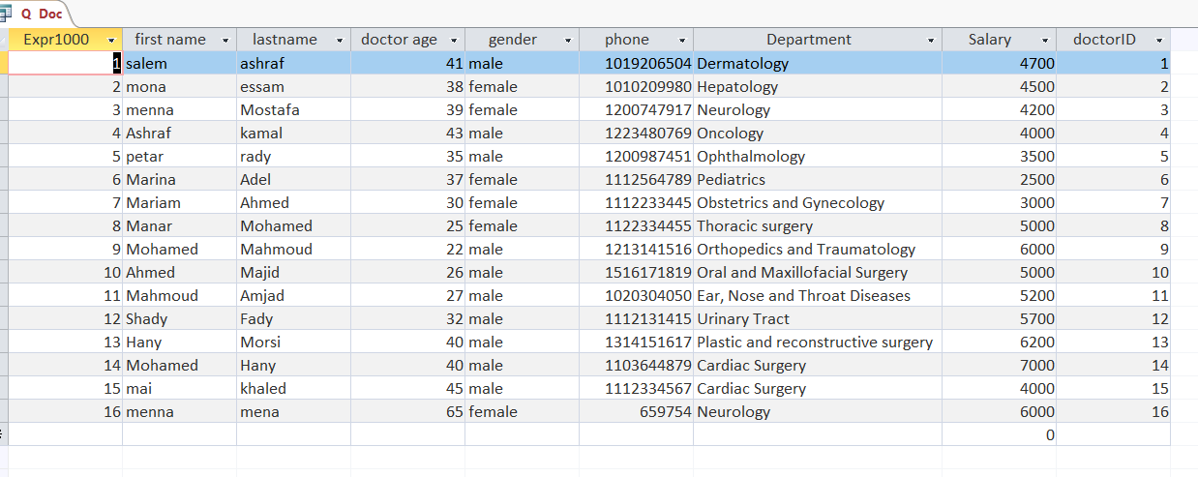

Slide 12


Slide 13
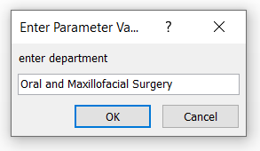
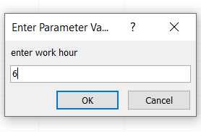


Query update

Slide 14
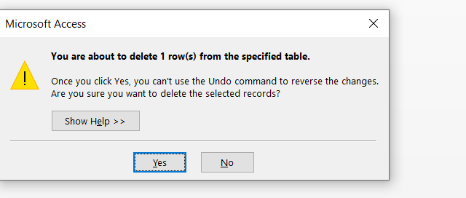
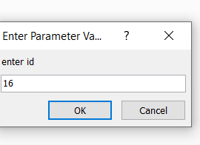

QUERY DEL

Slide 15
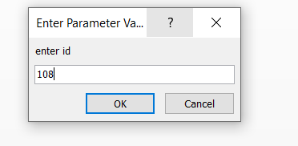
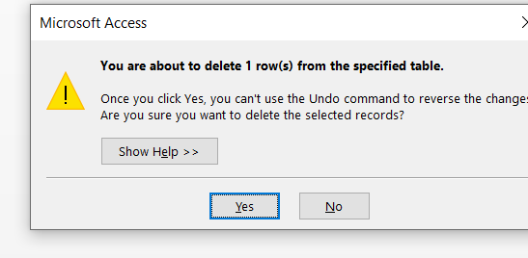

Query DEL

Slide 16
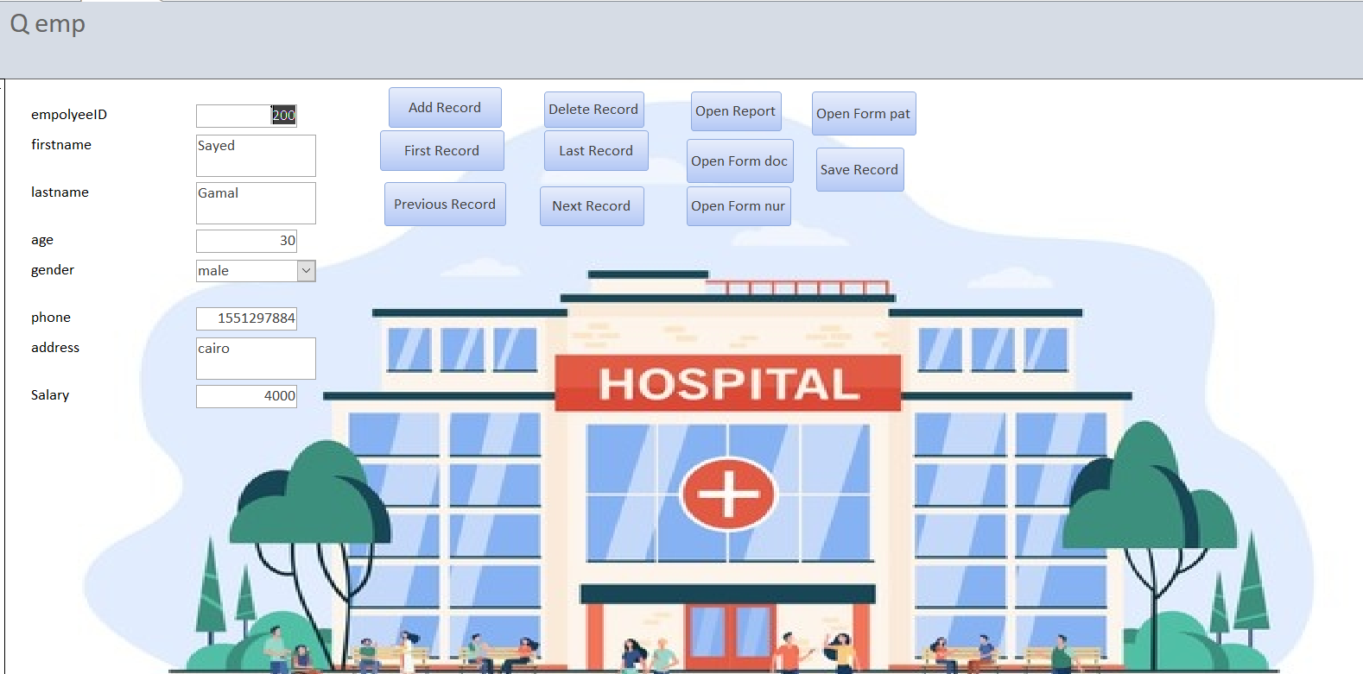
FORM

Slide 17
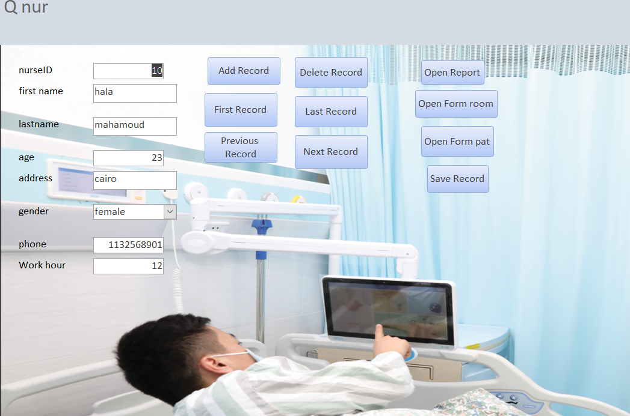

Slide 18
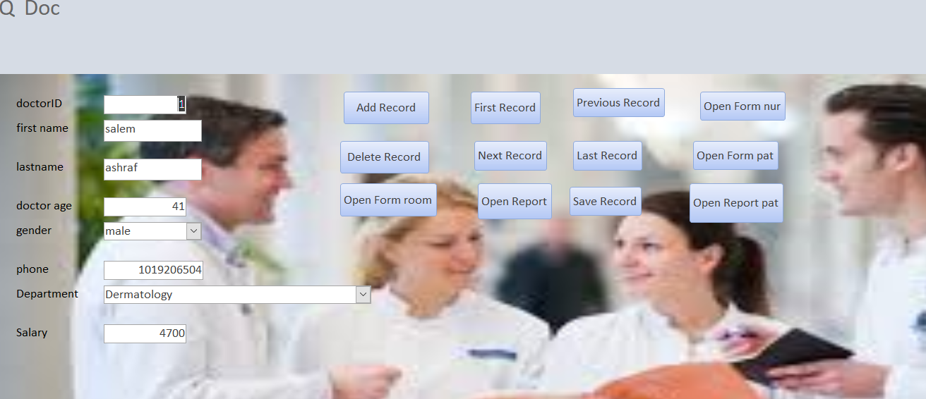

Slide 19
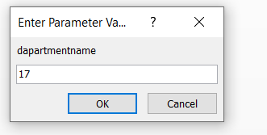
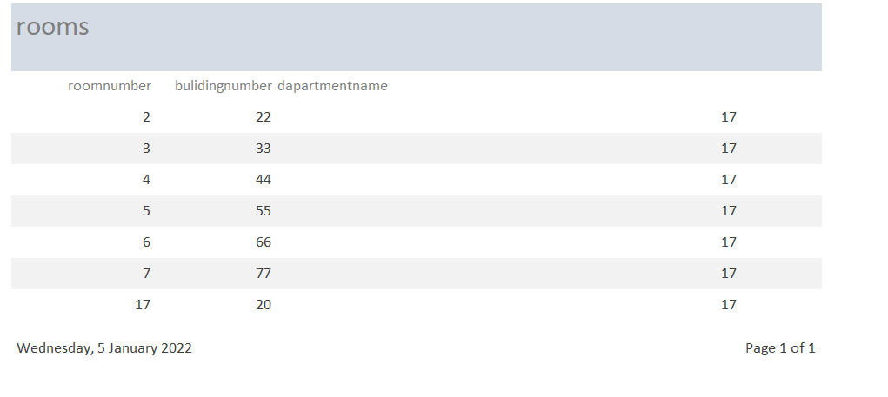
REPORT

Slide 20
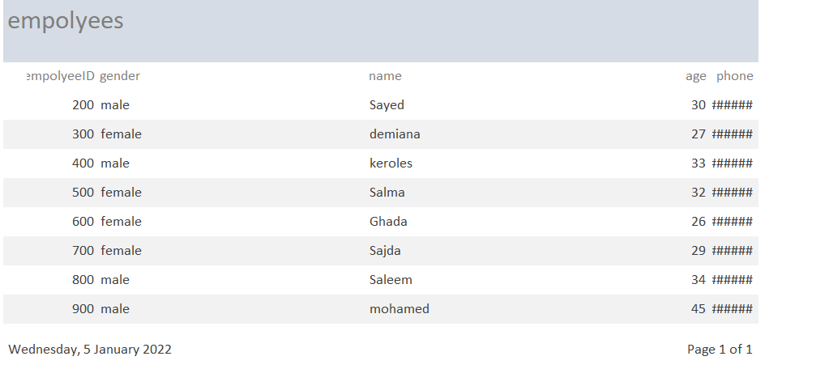

Slide 21
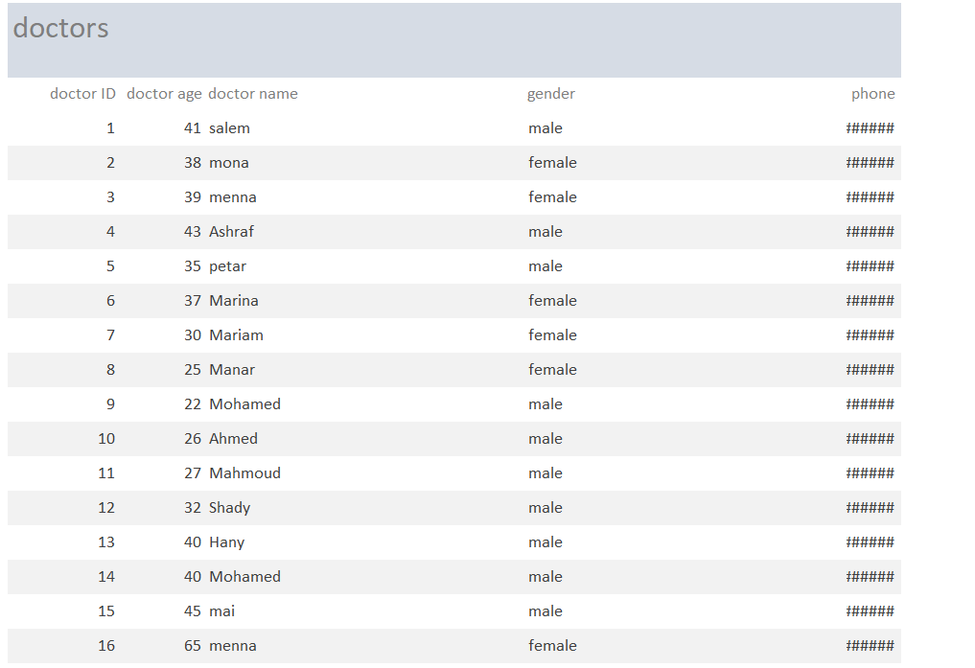

Slide 22
Link github
https://github.com/AbduSenousi/proj.IS.hospital.56.git

